Slide 2
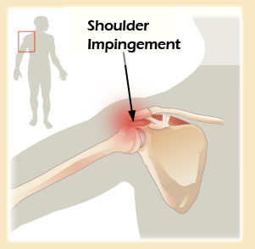
Corrective Exercises in prevention of
Shoulder Injuries

Slide 3
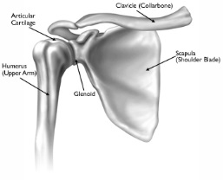
Introduction
Normal shoulder function is essential for many popular sports and shoulder dysfunction causes significant impairment of everyday quality of life.
Unlike the hip joint, which has a deep socket, the glenoid cavity is a shallow socket and is inherently unstable.
Notes:
The glenohumeral joint is a ball and socket joint. Unlike the hip joint, which has a deep socket, the glenoid cavity is a shallow socket and is inherently unstable. The relationship between the humeral head and the glenoid cavity has been likened to a seal balancing a ball on its nose. This implies that shoulder stability arises from a dynamic ball and socket stability that involves other structures. This additional stability is provided by static constraints the glenohumeral ligaments, glenoid labrum and capsule and dynamic constraints, predominantly the rotator cuff and scapular stabilizing muscles (Fig. 17.1).

Slide 4
Injuries of the shoulder
Shoulder pain is the most frequent in swimmers prevalence between 40% and 91%.
91% out of 80 young elite swimmers reported an episode of shoulder pain.
81% demonstrated a positive impingement sign.
Notes:
Shoulder pain is the most frequent injury in swimmers, with a reported prevalence between 40% and 91%. In contrast to most other sports, where the legs initiate the propulsive force, swimming athletes primarily use their arms to generate forward thrust. Swimmers at the elite level may swim up to 9 miles per day (more than 2500 shoulder revolutions).
Kennedy and Hawkins coined the term “swimmer’s shoulder,” for which they described anterior shoulder pain during and after workouts. Originally, the cause of pain was thought to be impingement of the rotator cuff tendons under the coracoacromial arch.
In a recent study, 91% out of 80 young elite swimmers (13-25 years old) reported an episode of shoulder pain. Eighty-four percent demonstrated a positive impingement sign.

Slide 5
Impingement
The shoulder impingement occurs when the rotator cuff tendons are impinged as they pass through the subacromial space formed between the acromion, coracoacromial arch and AC joint above and the glenohumeral joint below.
Notes:
Before discussing the commonly diagnosed shoulder conditions in detail, it is important to understand the concept of rotator cuff impingement. Despite the popularity of the label ‘impingement’ as a diagnostic entity in patient charts, rotator cuff impingement is a clinical sign, not a diagnosis. The exact pathophysiology of impingement is not completely clear but current opinion suggests that shoulder impingement occurs when the rotator cuff tendons are impinged as they pass through the subacromial space formed between the acromion, coracoacromial arch and AC joint above and the glenohumeral joint below. The impingement causes mechanical irritation of the rotator cuff tendons and may result in swelling and damage to the tendons. The exact reason for the change in the tendon or the space is not known.

Slide 6
The scapular stabilizers also play an important role in shoulder joint movement.
Glenohumeral movement requires the scapulothoracic, acromioclavicular (AC) and sternoclavicular joints to also move.
Normal shoulder function requires smooth integration of movement of these joints. This integrated movement is referred to as ‘scapulohumeral rhythm’.

Slide 7
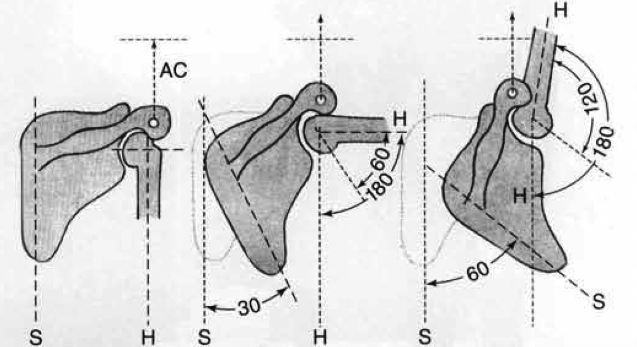
Scapulohumeral Rhythm
The scapula moves 1 degree for 2 degrees of humeral motion.
On completion of shoulder flexion, the glenohumeral joint motion is 120 degrees and the scapulothoracic motion is 60 degrees.
Notes:
During the first 60 degrees of shoulder flexion and 30 degrees of abduction the movement of the scapula is highly variable. Inman and Saunders termed this the setting phase. After the setting phase the humerus and scapula move in a constant ratio. A ratio of 2 degrees of glenohumeral motion for 1 degree of scapulothoracic motion results in 120 degrees of glenohumeral joint motion and 60 degrees of scapular motion at the completion of shoulder flexion (Figure 5-14). More recent studies have reported some variability in the exact timing of that motion.2,6,7 In analyzing patients who have pain, comparing one shoulder with the other provides a reference point to guide the examiner in making a decision as to whether the movement is impaired or just a normal variation. Observations of deviations in timing and range of scapular motion combined with the timing of the onset of pain and identification of impairments of muscle performance further guide decisions regarding the importance of the deviations.

Slide 8
Scapular movement ensures that the coracoacromial arch is removed from the path of the upwardly elevating humerus, in particular its greater tuberosity, via upward rotation of the scapula, thus avoiding potential impingement.

Slide 9
Because the scapula plays a critical role in controlling the position of the glenoid, relatively small changes in the action of thoracoscapular muscles can affect the alignment and forces involved in movement around the glenohumeral joint.
Notes:
The observation of the movement characteristics and their effect on symptoms are the primary guides to the diagnosis and treatment of the movement impairments. If symptoms are associated with the impairment, the correction of the movement will alleviate the symptoms. For example, increasing the amount of lateral humeral rotation during shoulder flexion/elevation often eliminates the shoulder pain caused by one form of impingement. Because the scapula plays a critical role in controlling the position of the glenoid, relatively small changes in the action of thoracoscapular muscles can affect the alignment and forces involved in movement around the glenohumeral joint.

Slide 10
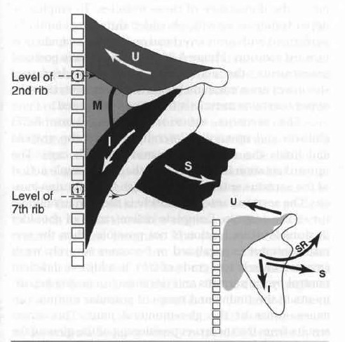
Scapular force couple
Notes:
The upper and lower trapezius muscles are one component of the force couple acting to rotate the scapula upwardly. The serratus anterior muscle is the other component. The adduction action of the trapezius is counterbalanced by the abduction action of the serratus anterior muscle.

Slide 11
The levator scapula
The levator scapula muscle adducts and downwardly (medially) rotates the scapula.
This muscle is a synergist of the trapezius for adduction but an antagonist for rotation.

Slide 12
The rhomboid muscles
The rhomboid muscles adduct and downwardly (medially) rotate the scapula.
Similar to the levator scapula muscle, the rhomboid muscles are both synergists and antagonists of the trapezius muscles.
These muscles usually become more dominant than the trapezius muscles and can restrict upward rotation of the scapula.

Slide 13
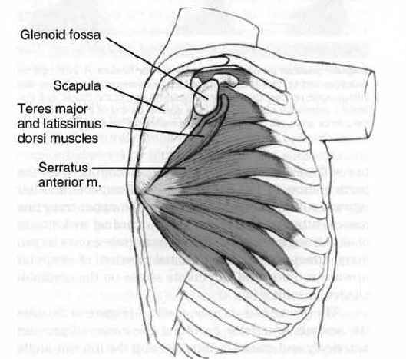
The serratus anterior muscle
The serratus anterior muscle is the only effective abductor of the scapula. The serratus has an important role in upward rotation of the scapula and in keeping the scapula adhered to the thorax.
Notes:
The serratus anterior muscle (Figure 5-27) abducts and upwardly (laterally) rotates the scapula and holds the scapula flat against the rib cage. The upward rotation is produced by the force couple action of the serratus anterior muscle with the trapezius muscle. The serratus anterior muscle is the primary abductor of the scapula. Complete active range of shoulder flexion/elevation motion is not possible when the serratus anterior is paralyzed or becomes severely weak (manual muscle test grade of 2/5). In addition, deficient control by the serratus anterior muscle, causing impairments in the timing and range of scapular motion, can cause stress at the glenohumeral joint. This stress results from the incorrect positioning of the glenoid for glenohumeral joint motion when there is insufficient abduction and upward rotation of the scapula. If the scapula is not correctly positioned during shoulder flexion or abduction, the scapulohumeral muscles will not be able to maintain their optimal length and tension relationships. The inferior angle of the scapula reaching the midline of the lateral side of the thorax when the shoulder is in full flexion, as well as the scapula being upwardly rotated 60 degrees at the completion of shoulder flexion, is a guide to the correct action of the serratus anterior muscle.

Slide 14
Pectoralis Major and Latissimus Dorsi
Impairments of the pectoralis major and the latissimus dorsi muscles can contribute to glenohumeral joint dysfunction.
These muscles can contribute to disruption of scapulohumeral rhythm.
The pectoralis major muscle, if not appropriately counterbalanced by muscles such as the subscapularis muscle, can contribute to excessive anterior glide of the humeral head.
Notes:
Impairments of the pectoralis major (Figure 5-31) and the latissimus dorsi (see Figure 5-24) muscles can contribute to glenohumeral joint dysfunction. These muscles essentially bypass the scapula and attach directly to the humerus and can contribute to disruption of scapulohumeral rhythm. Because both of these muscles are medial rotators of the humerus and are powerful muscles with strong and extensive attachments to the axial skeleton, the range of shoulder lateral rotation can be limited during the last one third of the range of shoulder flexion if they become short or stiff. The pectoralis major muscle, if not appropriately counterbalanced by muscles such as the subscapularis muscle, can contribute to excessive anterior glide of the humeral head.

Slide 15
The Deltoid muscle
The anterior portion of the deltoid muscle flexes and medially rotates the humerus.
The posterior portion extends and laterally rotates the humerus.
The middle portion abducts the humerus.
This is a powerful muscle and from the rest position generates a superiorly directed vector that pulls the humeral head toward the acromion.
Therefore it is essential that the depressors of the humeral head, primarily the supraspinatus, infraspinatus, teres minor, and subscapularis muscles, adequately offset the proximal pull of the deltoid muscle.
Notes:
abducts the humerus. The anterior portion of the deltoid muscle flexes and medially rotates the humerus, the posterior portion extends and laterally rotates the humerus, and the middle portion abducts the humerus. This is a powerful muscle and from the rest position generates a superiorly directed vector that pulls the humeral head toward the acromion. Therefore it is essential that the depressors of the humeral head, primarily the supraspinatus, infraspinatus, teres minor, and subscapularis muscles, adequately offset the proximal pull of the deltoid muscle.

Slide 16
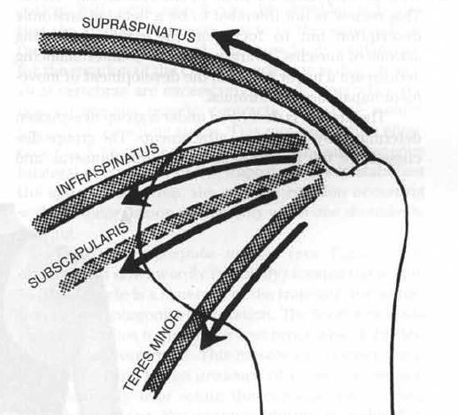
The rotator cuff muscles
The rotator cuff muscles exert a downward pull on the humeral head during shoulder flexion. The infraspinatus and teres minor muscles also laterally rotate the humerus during shoulder flexion.
Notes:
Therefore the scapulohumeral muscles that depress the head of the humerus must offset the strong upward pull of the deltoid muscle and must laterally rotate the humerus to prevent the greater tuberosity from impinging on the coraco acromial ligament or the acromion (Figure 5-21). If the pectoralis major and latissimus dorsi muscles depress the head of the humerus, they will also medially rotate it and can alter the timing of humeral motion with the scapula and the position of the humerus relative to the glenoid.

Slide 17
The supraspinatus muscle
The supraspinatus muscle abducts and laterally rotates the shoulder, depresses, and stabilizes the humeral head in the glenoid.
Because this muscle passes under the acromion, it is particularly vulnerable to injury when the shoulder is depressed.
If the humeral head (1) glides superiorly, (2) does not glide inferiorly during shoulder flexion and abduction, or (3) does not laterally rotate enough to prevent impingement of the greater tuberosity against the coracoacromial ligament, then the supraspinatus muscle and tendon are exposed to compression forces.
Notes:
The supraspinatus muscle (Figure 5-38) abducts and laterally rotates the shoulder, depresses, and stabilizes the humeral head in the glenoid. Because this muscle passes under the acromion, it is particularly vulnerable to injury when the shoulder is depressed. If the humeral head (1) glides superiorly, (2) does not glide inferiorly during shoulder flexion and abduction, or (3) does not laterally rotate enough to prevent impingement of the greater tuberosity against the coracoacromial ligament, then the supraspinatus muscle and tendon are exposed to compression forces (Figure 5-39).

Slide 18
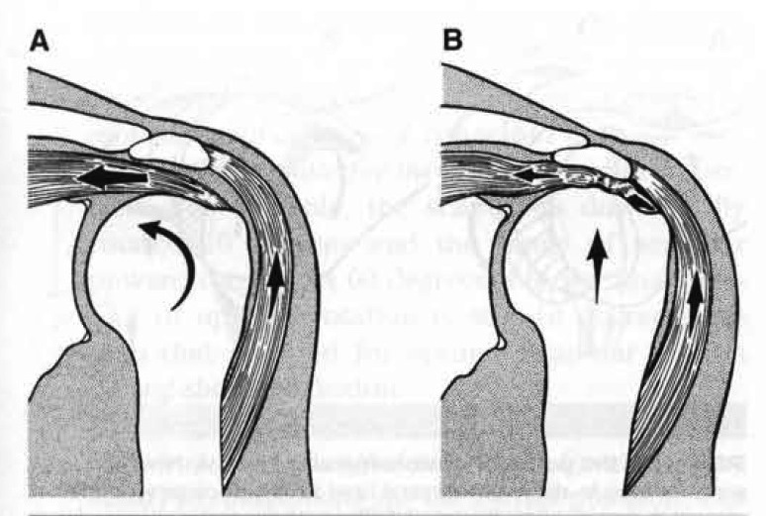
Compression of the supraspinatus tendon
If downward pull of the humerus by the rotator cuff muscles is insufficient to counteract, the upward pull from the deltoid, the supraspinatus tendon can be impinged.

Slide 19
Teres minor and Infraspinatus muscles
The infraspinatus and teres minor muscles are the primary lateral rotator muscles that depress the head of the humerus, with some assistance from the supraspinatus.
The teres minor muscle laterally rotates and depresses the head of the humerus.
This muscle has the same important role in depressing and laterally rotating the humeral head as the infraspinatus muscle.
Deficiencies in performance of these two muscles are very common.
Notes:
The teres minor muscle (see Figure 5-38) laterally rotates and depresses the head of the humerus. This muscle has the same important role in depressing and laterally rotating the humeral head as the infraspinatus muscle. Deficiencies in performance of these two muscles are very common. Shortness or greater stiffness of the teres minor and infraspinatus muscles relative to the stiffness of the axioscapular muscle is common (Figure 5-41). Shortness of the lateral rotators can contribute to excessive anterior and superior glide of the humeral head.

Slide 20
The Subscapularis Muscle
The subscapularis muscle medially rotates the humerus and depresses the head of the humerus.
This muscle has a particularly important role because of its angle of pull, acting not only to depress the head of the humerus but also to pull it posteriorly, thus offsetting the muscles acting to cause an anteriorsuperior glide of the humerus.
If the subscapularis becomes long or weak, the result can be excessive anterior glide of the humeral head, which has been cited as a precursor to impingement syndrome.
Notes:
The subscapularis muscle (see Figure 5-38) medially rotates the humerus and depresses the head of the humerus. This muscle has a particularly important role because of its angle of pull, acting not only to depress the head of the humerus but also to pull it posteriorly, thus offsetting the muscles acting to cause an anteriorsuperior glide of the humerus. Because large powerful muscles such as the pectoralis major and latissimus dorsi muscles are also medial rotators, the subscapularis muscle often becomes less dominant. If the subscapularis becomes long or weak, the result can be excessive anterior glide of the humeral head, which has been cited as a precursor to impingement syndrome.

Slide 21
Scapulohumeral Muscles
The counterbalancing effects of the scapulohumeral muscles are critical to optimal control of the humerus in its relationship to the glenoid. The most common impairments are as follows:
Insufficient activity of the lateral rotators and therefore inadequate lateral rotation of the humerus to prevent the greater tuberosity from contacting the acromion.
Insufficient activity of the subscapularis muscle, which in turn allows the humeral head to glide anteriorly and superiorly.
Dominance of the deltoid muscle, causing the humeral head to glide superiorly.

Slide 22
Risk Factors of Shoulder Impingment
Muscle Activation
Alignment
Movement Pattern
Swimmer’s Posture
Increased activity
Decreased activity
Shoulder Medial Rotation Syndrome

Slide 23
Muscle Activation
Decreased activation: Serratus Anterior - Rotator Cuff Muscles - Lower Trapezius
Delayed activation: Middle - Lower Trapezius
Increased activation: Upper Trapezius - Middle Deltoid – Pectoralis Major – Pectoralis Minor

Slide 24
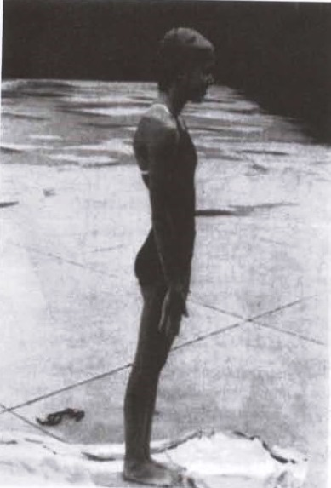
Alignment
Swimmer's posture: Sagittal posture analysis shows that this swimmer has forward shoulders and prominent lordosis.
Notes:
This posture could produce the weakness of the MT and SA muscles associated with scapular stability10). Also, the muscles must be activated strongly during shoulder abduction based on the scapulohumeral rhythm. The weakness of the MT and SA muscles causes the excessive activation of the UT11). Also, activation of the cPM disturbs arm elevation and causes the shoulder head to rotate medially during shoulder abduction10). Therefore, the changes in the shoulder muscles due to forward shoulder posture may become potential risk factors for evoking many shoulder disorders, such as impingement syndrome.

Slide 25
Shoulder Medial Rotation Syndrome
Muscle recruitment patterns:
During glenohumeral joint flexion/abduction, the shoulder medial rotators are recruited, particularly the pectoralis major and the teres major muscles.
The action of the latissimus dorsi muscle is dominant, causing excessive glenohumeral medial rotation.

Slide 26
Shoulder Medial Rotation Syndrome
MUSCLE LENGTH IMPAIRMENTS
Shortness of the glenohumeral joint medial rotators can limit the range into lateral rotation.
Shortness of the pectoralis major muscle
Shortness of the latissimus dorsi muscle
Teres major muscle shortness
Notes:
Shortness of the glenohumeral joint medial rotators can limit the range into lateral rotation.
• Shortness of the pectoralis major muscle can limit the range into flexion unless there is compensatory glenohumeral medial rotation or the rib cage elevates.
• Shortness of the latissimus dorsi muscle can limit glenohumeral joint flexion range unless there is compensatory humeral medial rotation or lumbar spine extension.
• Teres major shortness can be a factor because it is also a glenohumeral medial rotator.

Slide 27
NORMAL JOINT END RANGES OF MOTION
NORMAL JOINT END RANGES OF MOTION

Slide 28
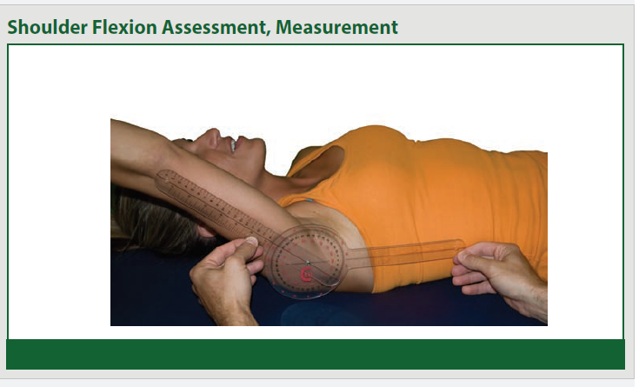
Range of Motion Assessments

Slide 29
Range of Motion Assessments

Slide 30
Range of Motion Assessments

Slide 31
Strength Assessment

Slide 32
Strength Assessment

Slide 33
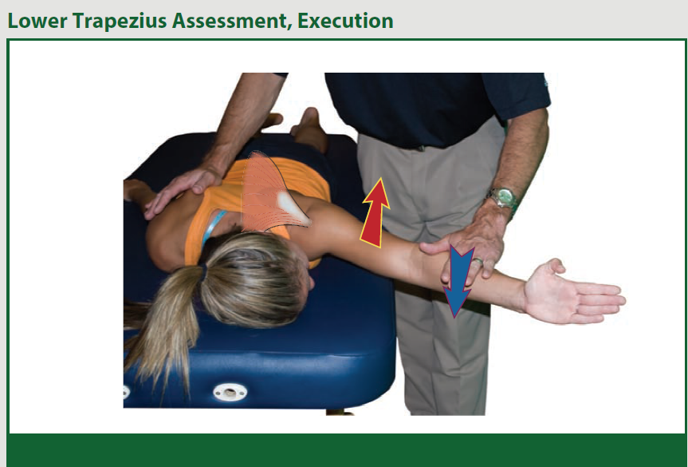
Strength Assessment

Slide 34
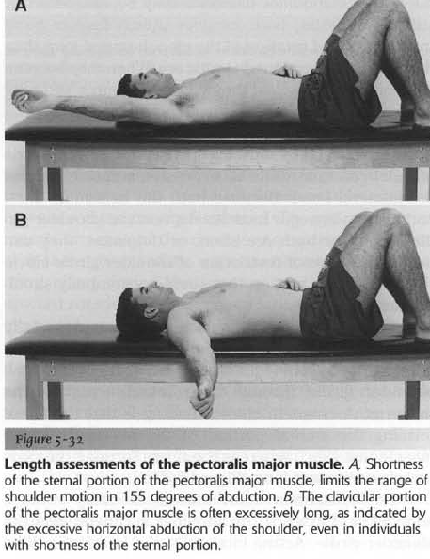
Length Assessment
A. Shortness of the sternal portion of the pectoralis major muscle, limits the range of shoulder motion in 155 degrees of abduction.
B, The clavicular portion of the pectoralis major muscle is often excessively long, as indicated by the excessive horizontal abduction of the shoulder, even in individuals with shortness of the sternal portion.

Slide 35
Length Assessment

Slide 36
Corrective exercise
The emphasis of the treatment program should be on improving the control of humeral lateral rotators.
if the medial rotators or teres major are short, they need to be stretched
resistive exercises can be used for the glenohumeral lateral rotators.
Sahrmann 2010

Slide 37
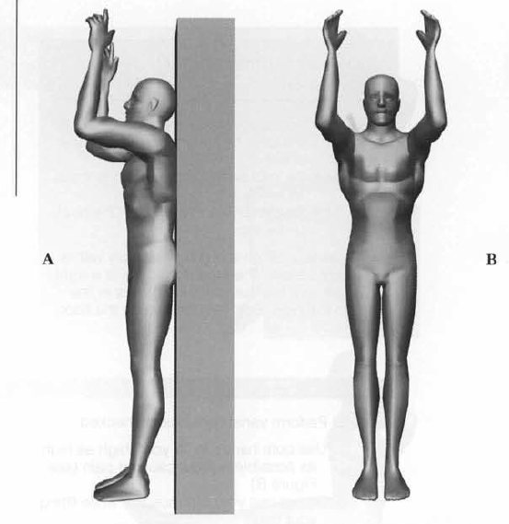
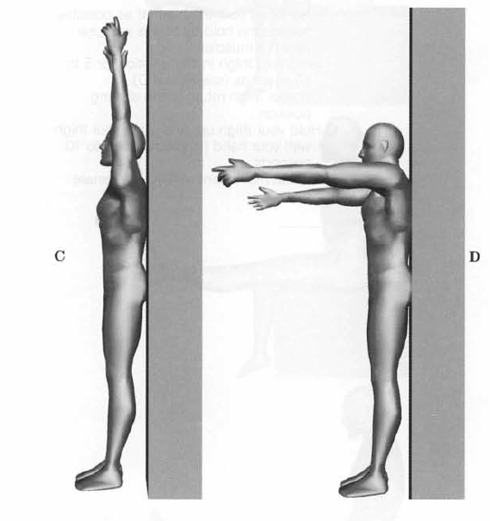
Corrective exercise

Slide 38
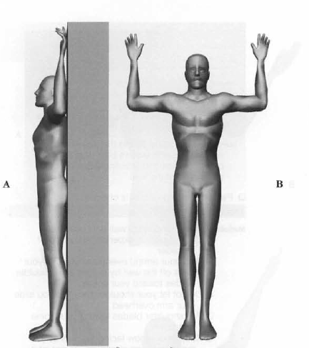
Corrective exercise

Slide 39
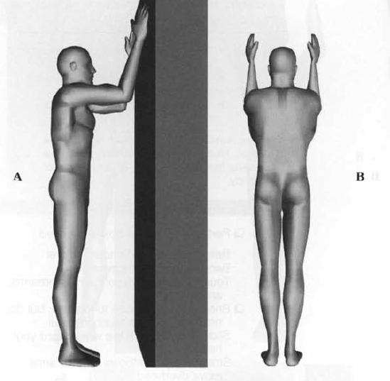
Corrective exercise

Slide 40
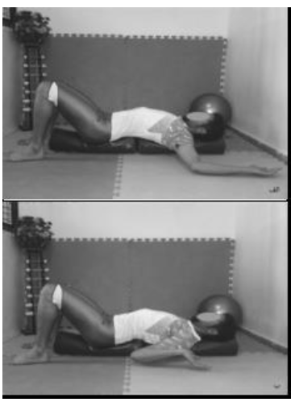
corrective exercise

Slide 41
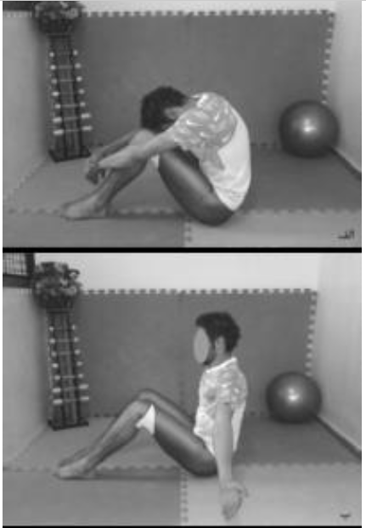
Corrective exercise

Slide 42
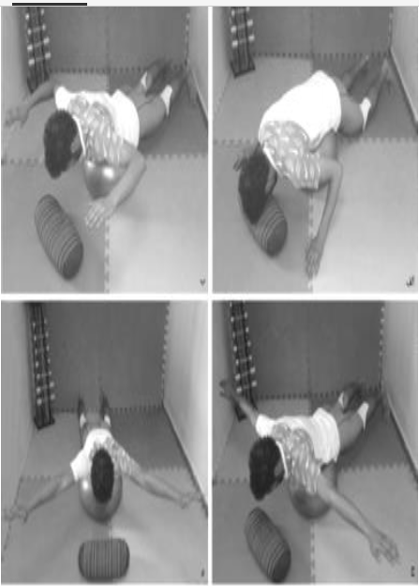
Corrective exercise

Slide 44
References
1. Brukner P, Khan K. Clinical sports medicine: McGraw Hill; 2006.
2. Hammer WI. Functional soft-tissue examination and treatment by manual methods: Jones & Bartlett Learning; 2007.
3. Phadke V, Camargo P, Ludewig P. Scapular and rotator cuff muscle activity during arm elevation: a review of normal function and alterations with shoulder impingement. Brazilian Journal of Physical Therapy. 2009;13(1):1-9.
4. Sahrmann S. Diagnosis and treatment of movement impairment syndromes: Elsevier Health Sciences; 2002.

Slide 45
References
5. Struyf F, Cagnie B, Cools A, Baert I, Van Brempt J, Struyf P, et al. Scapulothoracic muscle activity and recruitment timing in patients with shoulder impingement symptoms and glenohumeral instability. Journal of Electromyography and Kinesiology. 2014;24(2):277-84.
6. Wanivenhaus F, Fox AJ, Chaudhury S, Rodeo SA. Epidemiology of injuries and prevention strategies in competitive swimmers. Sports Health: A Multidisciplinary Approach. 2012;4(3):246-51.
7. Yoo W-g. Comparison of shoulder muscles activation for shoulder abduction between forward shoulder posture and asymptomatic persons. Journal of physical therapy science. 2013;25(7):815.
8. Clark M, Lucett S. (2010). "NASM essentials of corrective exercise training", Lippincott Williams & Wilkins.

